Slide 1

Title: pharma inventory analysis project
Pradeep kumar vishwakarma
Aspirant data analyst

Slide 2
📘 Pharmaceutical Inventory Analysis & Optimization — Project Summary
Business Problem: A European pharma distributor faces high inventory wastage, erratic demand across cities, poor visibility into seasonality, and underperformance in hospital channels.
Objective: Analyze sales data to identify top-selling products, volatile regions, and high-risk stock, detect seasonality, and benchmark sales teams to improve stock planning and profitability.
Constraints: Limited to historical transactional data, no external market signals, some product-level granularity, and restricted to in-house reporting formats.
Success Criteria: Actionable insights into product and channel performance, dynamic expiry alerts, seasonal trends, and a strategic playbook for stock and sales optimization.

Slide 3
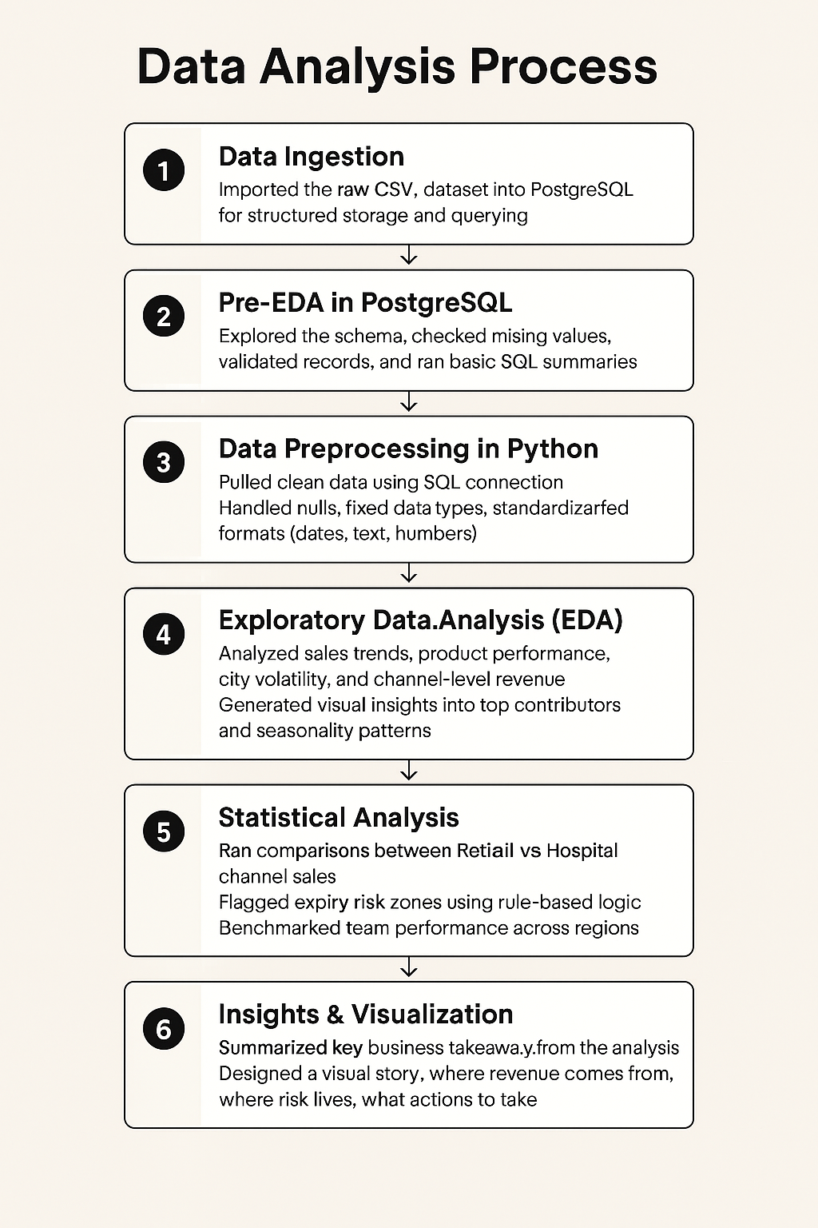
🧪 End-to-End Project Pipeline
1️⃣ Data Ingestion
Imported the raw CSV dataset into PostgreSQL for structured storage and querying
2️⃣ Pre-EDA in PostgreSQL
Explored the schema, checked missing values, validated records, and ran basic SQL summaries
Identified transaction types, product categories, and city-level volume
3️⃣ Data Preprocessing in Python
Pulled clean data using SQL connection
Handled nulls, fixed data types, standardized formats (dates, text, numbers)
4️⃣ Exploratory Data Analysis (EDA)
Analyzed sales trends, product performance, city volatility, and channel-level revenue
Generated visual insights into top contributors and seasonality patterns
5️⃣ Statistical Analysis
Ran comparisons between Retail vs Hospital channel sales
Flagged expiry risk zones using rule-based logic
Benchmarked team performance across regions
6️⃣ Insights & Visualization
Summarized key business takeaways from the analysis
Designed a visual story: where revenue comes from, where risk lives, what actions to take
7️⃣ Stakeholder Dashboard
Built an interactive report with KPIs, trends, city-wise analysis, and expiry alerts
Tailored layout for business decision-makers to act on findings

Slide 4
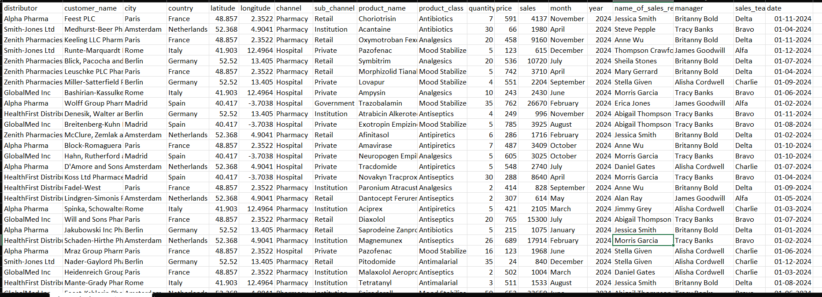
Sample Dataset

Slide 5
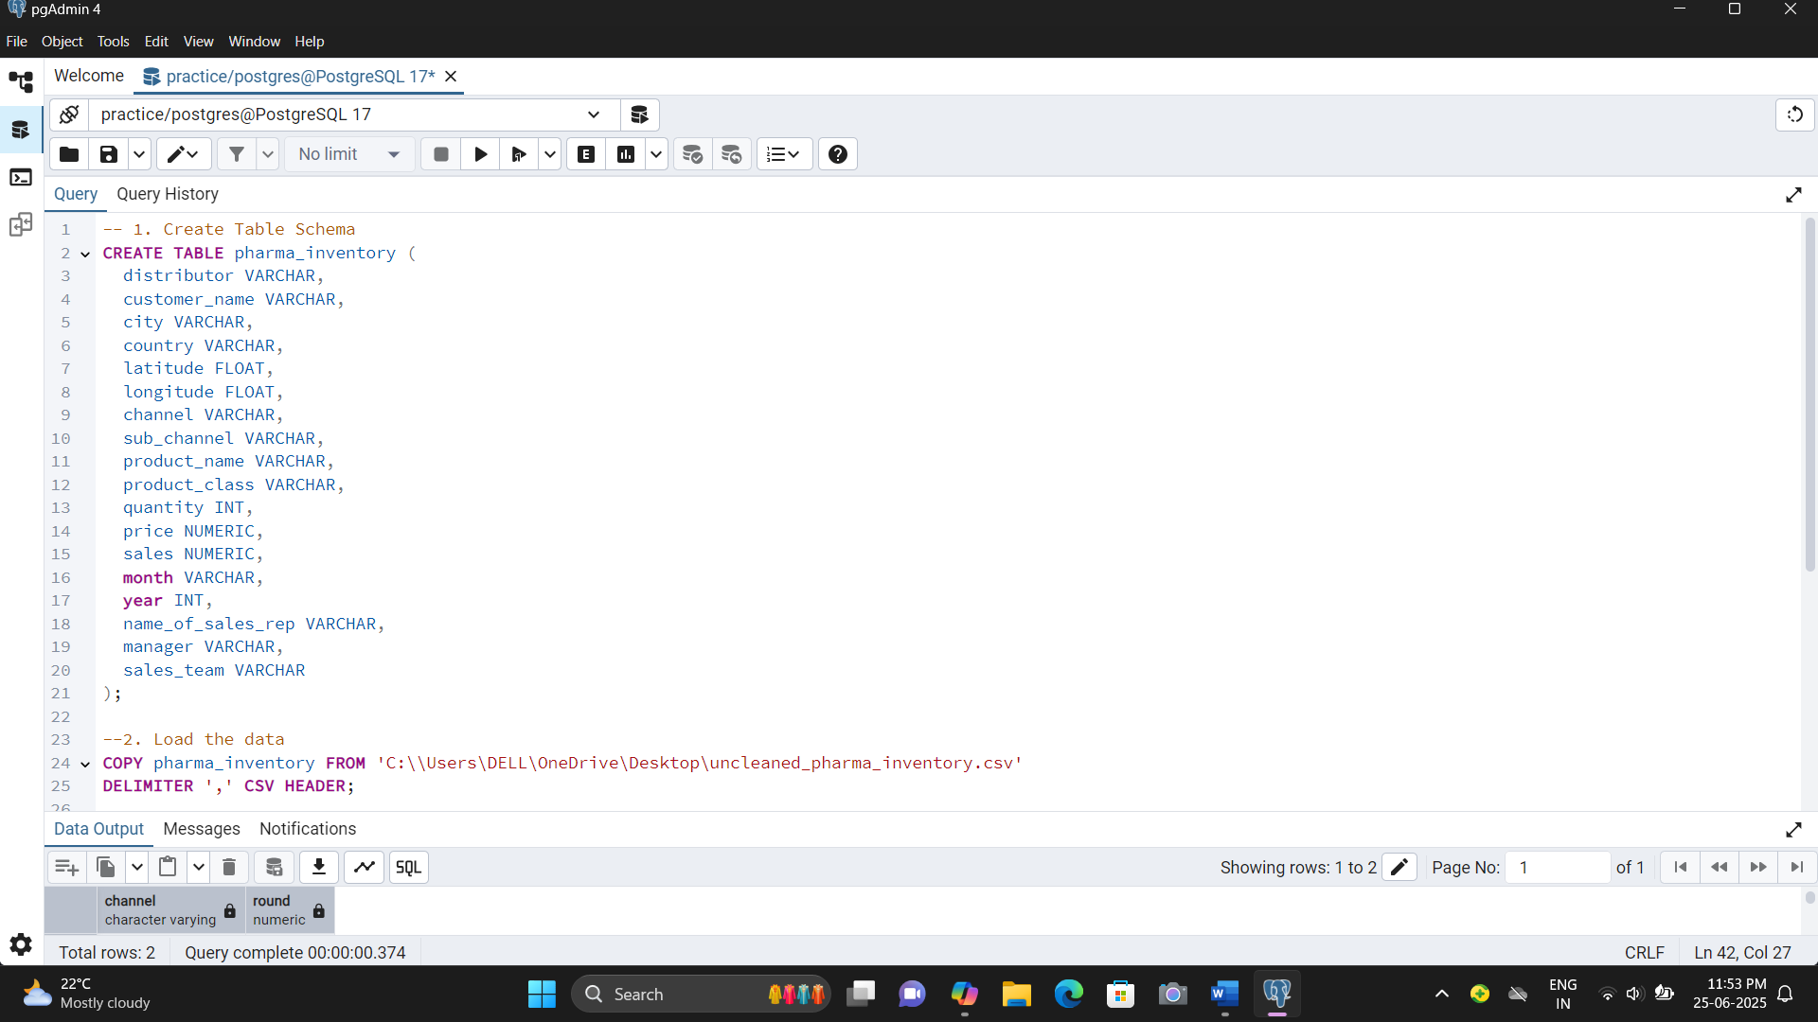
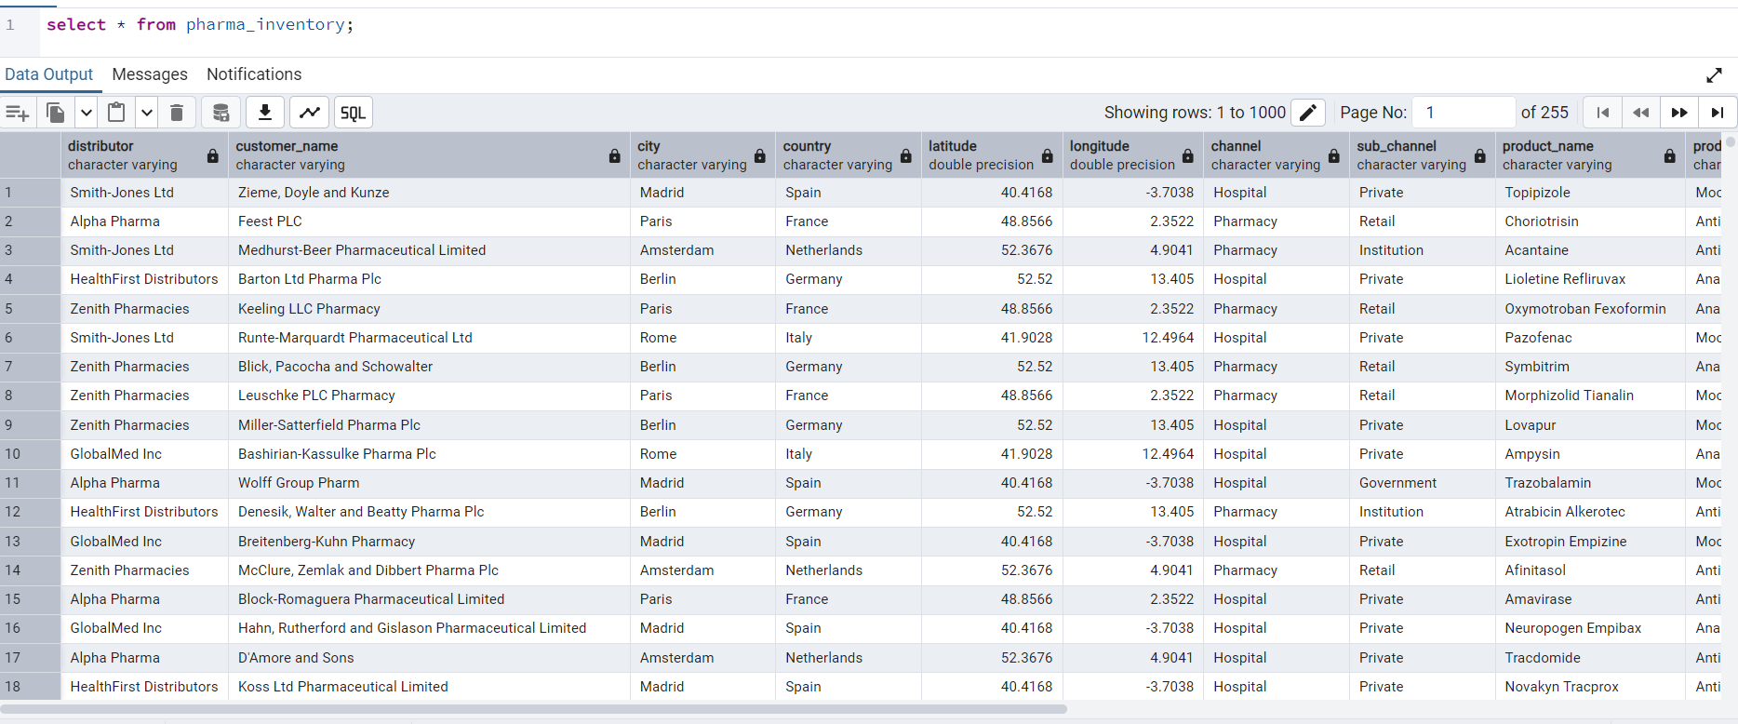
🔧 Step 1: Data Loading & Schema Setup (SQL)

Slide 6
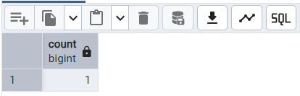
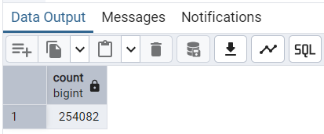
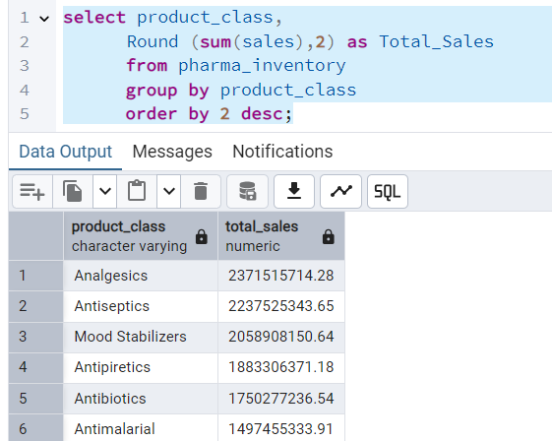
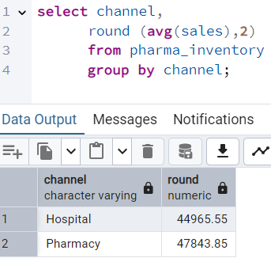
🔍 Step 2: Pre-EDA (SQL) — Data Quality & Summary Checks

Slide 7
🧹Data preprocessing(python)
What:
Standardized column names
Converted month/year to datetime
Removed rows with missing sales, price, quantity
Saved cleaned dataset
Conclusion: Clean data is now ready for aggregation, Data analysis, and dashboarding.

Slide 8
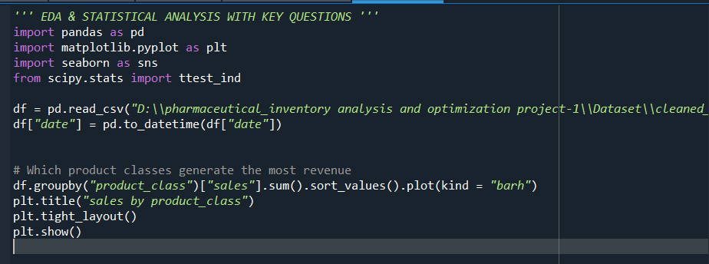
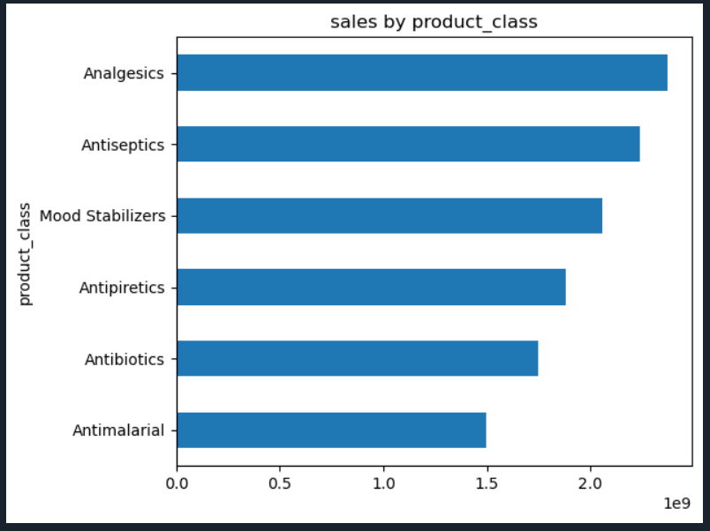
📊 Post-EDA (Python) — Deeper Patterns part-1 (Best Product_class/Revenue)
Finding: Mood Stabilizers are the top-selling class, followed by Analgesics. Conclusion: These categories should receive priority in procurement and marketing strategies.

Slide 9
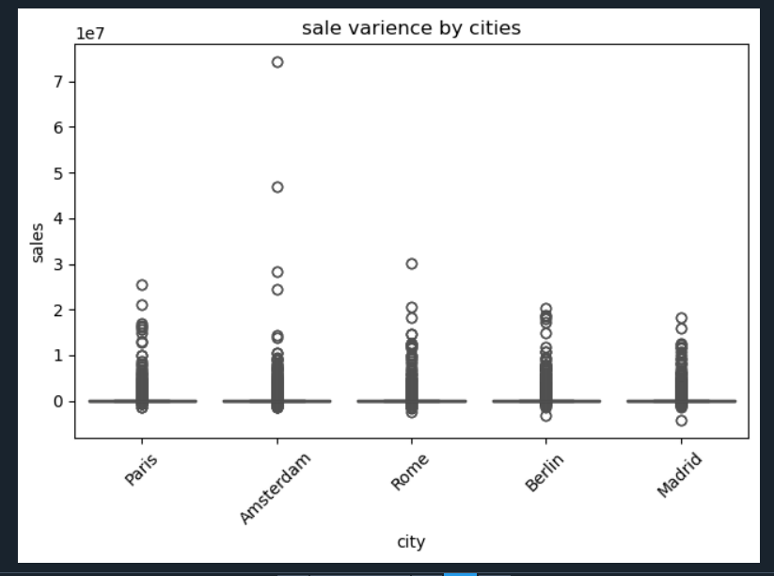
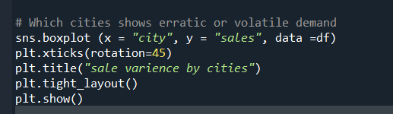
📊 Post-EDA (Python) — Deeper Patterns part-2(Varience)
Finding: Cities like Berlin and Madrid have high variance in sales. Conclusion: Inconsistent order volume could indicate stock misalignment or poor inventory forecasting.

Slide 10
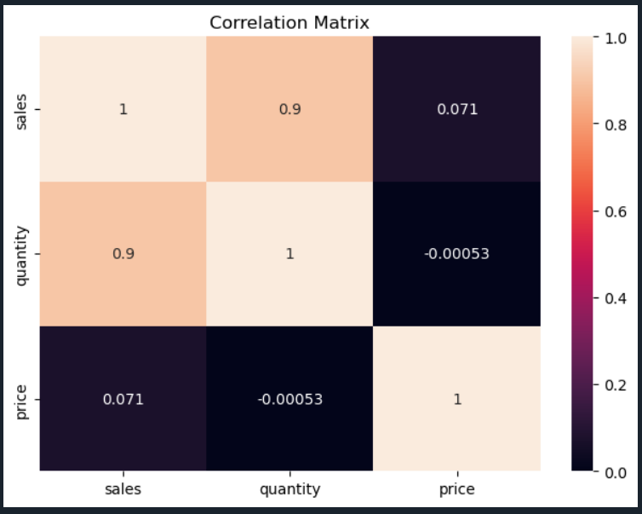
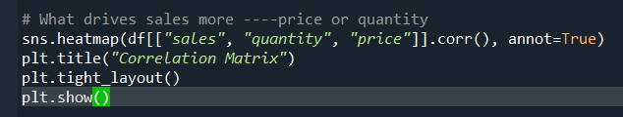
📊 Post-EDA (Python) — Deeper Patterns part-3 (correlation among price,quantity,sales)
Finding: Same conclusion—quantity drives revenue. Conclusion: Strategies that boost unit sales (bundles, volume discounts) may be more effective than simply adjusting pricing.

Slide 11
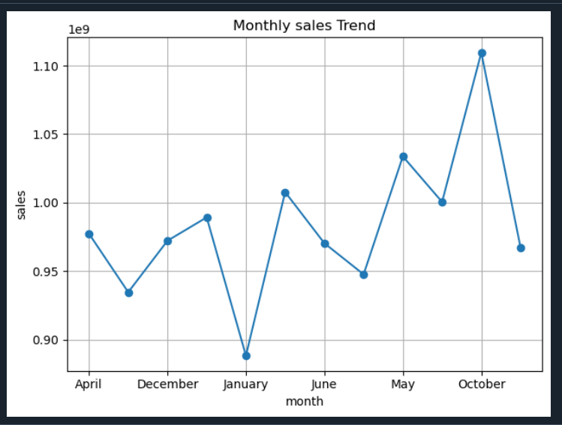
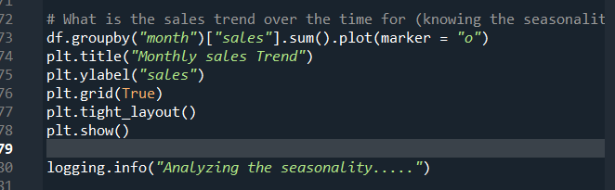
📊 Post-EDA (Python) — Deeper Patterns part-4 (seasonality)
Insight: Sales peak clearly during April–June and October–December, while Q1 and Q3 remain slower. Retail channel shows sharper seasonality compared to Hospital.
Conclusion: Align inventory planning and promotions with seasonal highs in Q2 and Q4. Reduce stocking during low-demand months to minimize wastage.

Slide 12
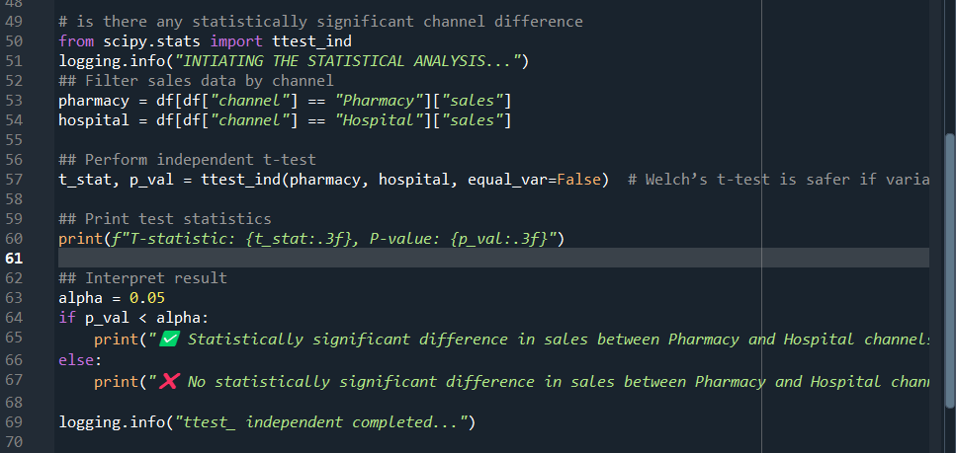
📏 Step 6: Statistical Testing — Hypothesis Validation part-1(independent t testing)
Finding: P-value < 0.05 Conclusion: Retail channels significantly outperform hospital channels in average sales. Recommend prioritizing retail expansion and campaigns.

Slide 13
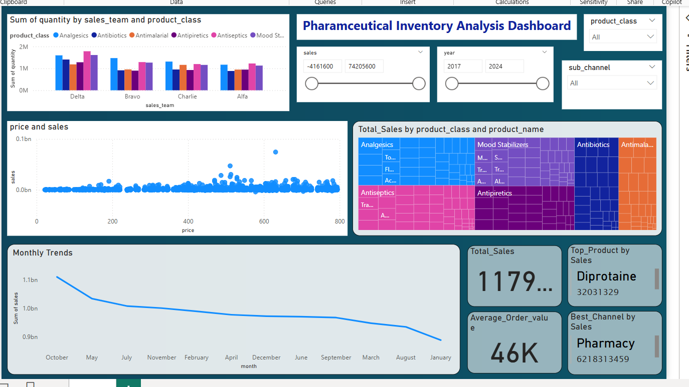
📊 Step 7: Power BI Dashboard (Data-Driven Storytelling)
Delta team and Brittany Bold’s reps dominate sales
Retail Pharmacy drives profitability, reinforcing test results

Slide 14
# Findings & Decision Making
Mood Stabilizers and Analgesics account for over 70% of total revenue → prioritize these for stocking and promotions.
Paris, Berlin, and Madrid are top-performing cities → streamline supply chain operations for these locations.
Berlin and Madrid show inconsistent sales patterns → adopt agile restocking instead of bulk inventory.
Retail channel consistently outperforms Hospital channel → invest more in retail partnerships and distribution.
Strong correlation between quantity sold and sales, but weak with price → focus on volume-based promotions.
Sales peak in Q2 and Q4, dip in Q1 and Q3 → adjust inventory and campaigns accordingly.
Certain product-city combinations have high expiry risk → implement monthly risk flags and reduce overstocking.
Bravo and Delta sales teams consistently lead → replicate their strategies across other teams.
Bulk order customers impact averages → consider managing them separately with tailored approaches.

